Slide 1

Marathwada Mitra Mandal's College of Engineering Karvenagar, Pune 52
Accredited with "A" Grade by NAAC
Recipient of "Best College Award" in AY 2018-19 from SPPU
Department of Information Technology
Project Review : SEM I
Project Title:‘BI-DIRECTIONAL SIGN AND SPEECH RECOGNITION USING MACHINE LEARNING’.
Project Group No: 3
Project Guide : Mr. Jitendra Chavan
Project Group Members:
1. Prajakta Bimalkhedkar BI06
2. Devika Rembhotkar BI34
3. Sanjana Pisute BI39

Slide 2
Agenda:
Introduction
Literature Review
Problem Statement
Purpose, Scope & Objectives
System Overview
Project Design (UML Diagrams)
Hardware & Software Requirements
Algorithms
Methodology
Outputs
Conclusion
References

Slide 3
Introduction
We all know there comes a huge communication gap when a normal person needs to communicate with people who have hearing aid/visual aid or even when the blind/deaf individuals need to communicate among themselves.
So in order to break this barrier of communication there needs to be a system that can enable conversion of sign language to voice or text and voice or text to sign language and do it in real time.
Hence by implementing this system we intent to create a communication system which will ease their lives in the daily lives, which will be also efficient , user friendly and cost effective.

Slide 4
Literature Review
Sr No. | Paper Title | Author | Description
1 | SVBiComm: Sign-Voice Bidirectional Communication System for Normal, "Deaf/Dumb"and Blind People based on Machine Learning | Mariam Moustafa Reda, Nada Gamal Mohammed, Rania Ahmed Abdel Azeem Abul Seoud | In this paper, a Blind/Normal to Deaf/Hard-of-Hearing Chat system (SVBiComm) is implemented to translate sign language gestures into the corresponding computer generated/human speech gestures. The proposed system faces some difficulties and restrictions; the system needs the training data for both images and voice to be noiseless to train the recognition systems well. Also, there are many sign language limitations.
2 | Real-Time Two Way Communication System for Speech and Hearing Impaired Using Computer Vision and Deep Learning | Tanuj Bohra, Shaunak Sompura, Purva Raut, Krish Parekh | In this paper, a communication system is developed using image processing techniques and CNN. CNN model was able predict 17600 test images with an accuracy of 99% . The proposed system can make advances like using an expanded database which includes new signs and use cases, a mobile application which includes the same features and speed with which the desktop application operates.

Slide 5
Sr No. | Paper Title | Author | Description
3 | Portable Communication Aid for Specially Challenged : Conversion of Hand Gestures into Voice and ViceVersa | T . MeeraDevi , K . M . Shravana Raju | In this paper, a system has been developed for set of different words and its voice and for different gestures which will be useful for the normal persons to communicate with differently abled persons. The drawback of this system is, it is a fixed dataset of words and voice inputs and also it is not yet developed as a handheld device as a guide for the specially challenged people.
4 | Text recognition and face detection aid for visually impaired person using RASPBERRY PI | Mr.Rajesh M., Ms. Bindhu K. Rajan , Ajay Roy, Almaria Thomas K, Ancy Thomas, Bincy Tharakan T, Dinesh C | The implemented idea involves text recognition and faces detection from image taken by camera on spectacle and recognizes the text using OCR. Conversion of the recognized text file to voice output by eSpeak algorithm. The proposed system can be improved through addition of various components. Addition of GPS to the present system will enable the user to get directions and it could give information regarding present location of the user
5 | AI based Reading System for Blind using OCR | Abhishek Mathur, Akshada Pathare, Prerna Sharma, Sujata Oak | This application detects the text using the camera and scans the text and then converts it into digital text which is recognized by the system and displays the translated text and gives speech output.

Slide 6
Sr No. | Paper Title | Author | Description
6 | Development of GUI for Text-Speech Recognition using Natural Language Processing | Partha Mukherjee, Soumen Santra. | In the present paper, a Text to speech synthesizer is developed that converts text into spoken word, by analyzing and processing it using Natural Language Processing (NLP) and then using Digital Signal Processing (DSP) technology to convert this processed text into synthesized speech representation of the text.
7 | Speech to Text Conversion for Multilingual Languages. | Yogita H. Ghadage, Sushama D. Shelke. | The current work presents a multilingual speech to text conversion system. The proposed system is implemented using Me Frequency Cepstral Coefficient (MFCC) feature extraction technique and Minimum Distance Classifier, Support Vector Machine (SVM) methods for speech classification. Speech utterances are pre-recorded and stored in a database. Similarity between these features and reference feature vector is computed and words having maximum similarity are given as output. The system is developed in MATLAB (R2010a) environment.
Table 1:Literature Review

Slide 7
PROBLEM STATEMENT
To implement a bidirectional communication system which will convert the sign language-text-speech for blind/normal individuals and speech-text-sign language to assist deaf/dumb.

Slide 8
PURPOSE OF THE PROJECT
•Purpose of the project : We aim to creating a technique with which we can establish a sound communication system between normal and deaf/dumb and blind individuals. To reflect their assessed needs and respects their choice with facilitating their life by integrating them into the society..

Slide 9
OBJECTIVE OF THE PROJECT
To give the deaf and blind people an individualized and appropriate communication system that supports different communication techniques, strategies and modes.
The goal of this project is to design a desktop human computer interface application that is used to facilitate communication between normal, "deaf/dumb" and blind people.

Slide 10
SCOPE OF THE PROJECT
To provide a system that acts as an interpreter that performs the bidirectional translation of sign language and spoken language between vocal and hearing-impaired people.
To help blind/normal to listen to the gestures made by the deaf/dumb.
To help the deaf/dumb individual read or see the speech generated by the blind/normal person.
Any individual having visual or audio impairments could make use of this system to communicate effectively.

Slide 11
SYSTEM OVERVIEW
I) Preprocessing:
Pre-processing is a common name for operations with images at the lowest level of abstraction both input and output are intensity images. These iconic images are of the same kind as the original data captured by the sensor, with an intensity image usually represented by a matrix of image function values (brightness). The aim of pre-processing is an improvement of the image data that suppresses unwilling distortions or enhances some image features important for further processing, although geometric transformations of images (e.g. rotation, scaling, and translation) are classified among pre-processing methods here since similar techniques are used.
II) Feature Extraction:
Feature extraction is a part of the dimensionality reduction process, in which, an initial set of the raw data is divided and reduced to more manageable groups. So when you want to process it will be easier.
III) Classification:
Automatic Speech Recognition or ASR, as it's known in short, is the technology that allows human beings to use their voices to speak with a computer interface in a way that, in its most sophisticated variations, resembles normal human conversation

Slide 12
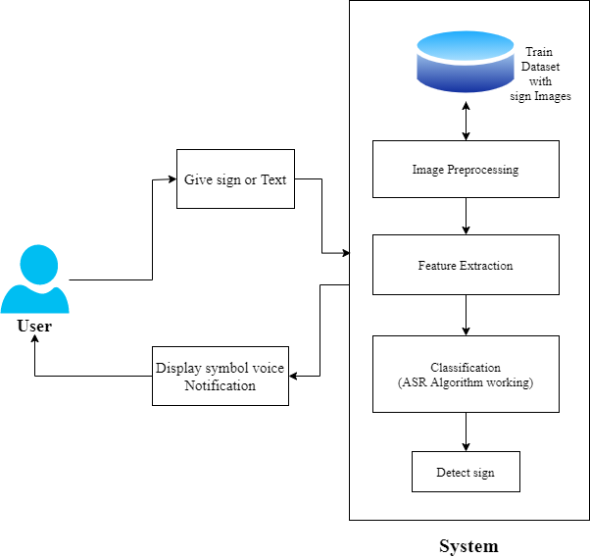
Figure 1:System Architecture

Slide 13
UML Diagrams
Sign – text - Speech
1. Flow Chart
Input
Image Preprocessing
Feature Extraction
Recognition
Text
Speech

Slide 14
2. Use Case Diagram
System
Sign Input
Image Processing
Feature Extraction
Recognition
Text-to-Speech API
Blind/Normal Person
Deaf/Dumb Person
Speech Output

Slide 15
3. Activity Diagram
Input
Image preprocessing
Noise Removal
Skin Detection
Skin Classifier
Feature Extraction
Image Recognition
Data Training
Text to Speech conversion

Slide 16
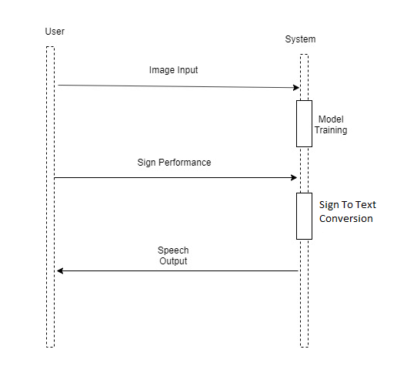
3. Sequence Diagram

Slide 17
B. Speech – text - sign
1. Flow chart
Speech Input
Speech- to-Text API
Text
Text Feature Extraction
Sign Output
o/p

Slide 18

2. Use Case Diagram
System
Speech Input
STT API
Text Feature Extraction
Blind/Normal Person
Deaf/Dumb Person
Sign Output

Slide 19
3. Activity Diagram
Speech input
Speech-to-Text API
Text Output
Text Feature Extraction
Sign Output

Slide 20
SOFTWARE REQUIREMENTS
OpenCV Library
Python
Spyder
TTS API
STT API
Draw.io

Slide 21
HARDWARE REQUIREMENTS
High quality microphone.
Digital camera having high performance computing.
Complex environment with non skin objects.

Slide 22
ALGORITHMS
A Convolutional Neural Network (CNN) is comprised of one or more convolutional layers and then followed by one or more fully connected layers as in a standard multilayer neural network. The architecture of a CNN is designed to take advantage of the 2D structure of an input image (or other 2D input such as a speech signal). This is achieved with local connections and tied weights followed by some form of pooling which results in translation invariant features. Another benefit of CNNs is that they are easier to train and have many fewer parameters than fully connected networks with the same number of hidden units.
Input: Hand sign gestures through webcam.
Output: Recognize gesture then classification and make sentences.
A CNN model is used to extract features from the frames and to predict hand gestures. The architecture of CNN consists of some convolution layers, each comprising of a pooling layer, activation function, and batch normalization which is optional. It also has a set of fully connected layers. As one of the images moves across the network, it gets reduced in size. This happens as a result of max pooling. The last layer gives us the prediction of the class probabilities.

Slide 23
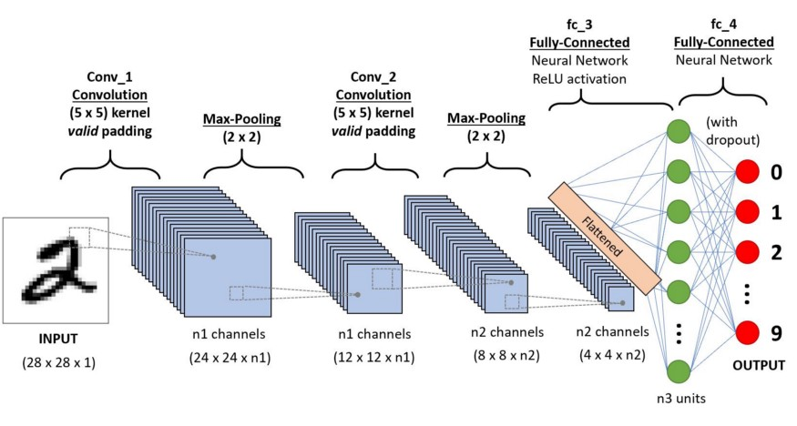
Figure 2:Convolutional Neural Network

Slide 24
ALGORITHMS
FIRST MODULE : SIGN-TEXT-SPEECH
1. IMAGE PROCESSING ALGORITHM : Image processing algorithms generally
constitute image extraction, noise reduction, edge sharpening, edge detection,
segmentation etc.
2. TEXT-TO-SPEECH(TTS) API :. Text-to-Speech (TTS) refers to the ability of
computers to read text aloud. A TTS Engine converts written text to a phonemic
representation, then converts the phonemic representation to waveforms that can be
output as sound.

Slide 25
• SECOND MODULE : SPEECH-TEXT-SIGN
1.SPEECH-TO-TEXT CONVERSION : The STT (speech-to-text) API features
enable recognizing sound data recorded by the user and sending the result as text.
2.TEXT-TO-SIGN : The text to sign conversion will be done using python. The
sentence or word to be converted to sign was taken as input.

Slide 26
METHODOLOGY
FIRST MODULE
1.IMAGE PROCESSING PART : The image processing part is mainly done using with the help of
OpenCV Library and Python language.
i. NOISE DETECTION USING MEDIAN FILTERING : Median filtering is used to maintain edges and remove noise. Each pixel is convoluted with its nearby neighbors to decide whether it represents its surroundings or not.
ii.SKIN DETECTION : Skin detection aims to find regions that have human faces and hands in images and to reject as much “non- skin” parts. This is done by transforming a specific pixel into the corresponding colored space.
iii. SKIN CLASSIFIER AND BINARY CLASSIFICATION : Used to indicate the boundary of the
skin color class in a feature space by identifying whether a pixel is part of the skin or not.All pixels in the image plane are classified into object and background pixels.

Slide 27
2. IMAGE RECOGNITION : The image obtained after the image processing step is then
given as an input to convolutional neural network which is then used to classify the images appropriately.
3. TEXT-TO-SPEECH CONVERSION : Speech synthesis tecchniques are used to convert input text to computer generated voice. It is used by the blind to listen to written material
SECOND MODULE
1.SPEECH-TO-TEXT CONVERSION : The voice from blind is converted into its
corresponding text using Speech-to-Text (STT) API.
2.TEXT-TO-SIGN CONVERSION : The text to sign conversion will be done using python.
The sentence or word to be converted to sign was taken as input.

Slide 28
OUTPUTS

Slide 29
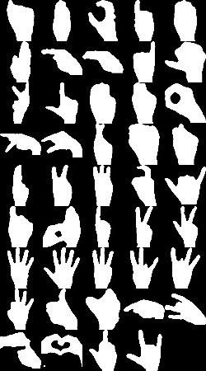
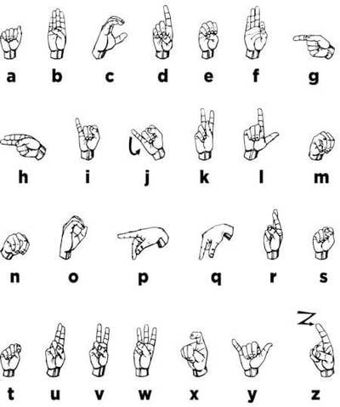
Figure 3: Database of gestures classified by our CNN Model

Slide 30

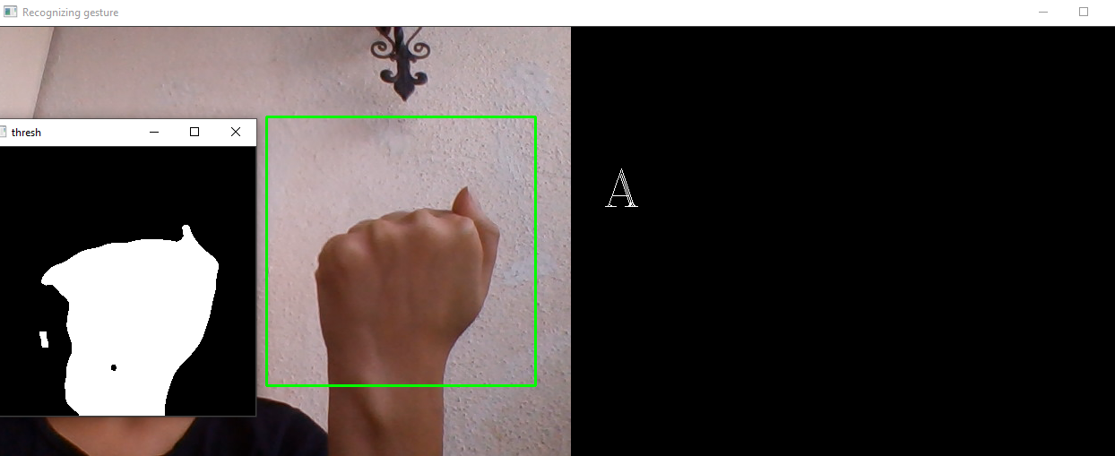

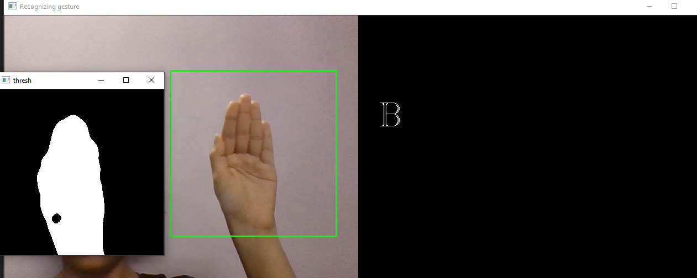
Figure 4: Expected and Received Output for Gesture A
Figure 5: Expected and Received Output for Gesture B

Slide 31

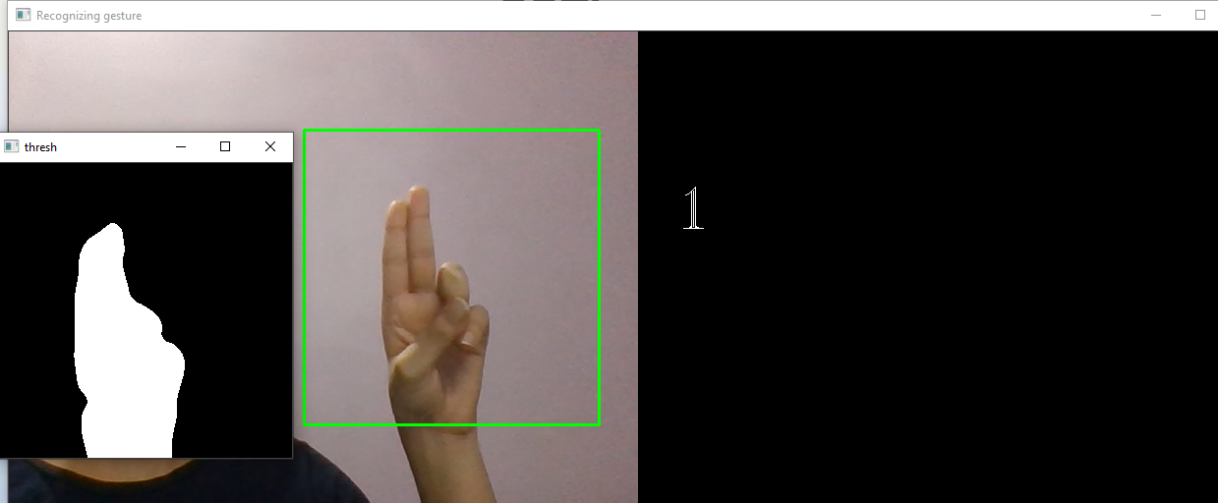

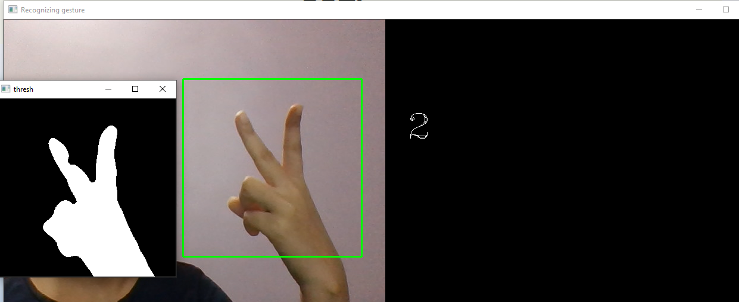
Figure 6: Expected and Received Output for Number 1
Figure 7: Expected and Received Output for Number 2

Slide 32
CONCLUSION
A Sign Language Recognition system is implemented to translate sign language gestures into the corresponding computer generated/human speech gestures for Blind/Normal to Deaf/Hard-of-Hearing .
This system is divided into two parts. The first part is the static sign recognition in which alphabets, finger spellings or words that require no motion of hands or face are recognized.
The second part is the voice recognition which is either isolated or continuous, isolated means where word by word is supplied to the server to recognize whereas continuous means a complete sentence is supplied to the server to recognize.
This system can operate on a commodity PC with lowcost cameras.

Slide 33
REFERENCES
Mariam Moustafa Reda, Nada Gamal Mohammed, Rania Ahmed Abdel Azeem Abul Seoud “SVBiComm: Sign-Voice Bidirectional Communication System for Normal,”Deaf/Dumb “and Blind People based on Machine Learning”, 978-1-5386-4427-0/18 ©2018 IEEE.
Tanuj Bohra,Shaunak Sompura,Purva Raut, Krish Parekh “Real-Time Two Way Communication
System for Speech and Hearing Impaired Using Computer Vision and Deep Learning”, Second International Conference on Smart Systems and Inventive Technology (ICSSIT 2019) IEEE Xplore Part Number: CFP19P17-ART; ISBN: 978-1-7281-2119-2.
T. MeeraDevi, K . M .ShravanaRaju “Portable Communication Aid for Specially Challenged: Conversion of Hand Gestures into Voice and ViceVersa ”, 978-1-5386-9432-9/18 ©2018 IEEE.
Mr.Rajesh M., Ms. Bindhu K. Rajan , Ajay Roy, Almaria Thomas K, Ancy Thomas, Bincy Tharakan T, Dinesh C “Text recognition and face detection aid for visually impaired person using RASPBERRY PI”, IEEE Xplore.

Slide 34
REFERENCES
Abhishek Mathur, Akshada Pathare, Prerna Sharma, Sujata Oak, “AI based Reading System for Blind using OCR”, ISBN: 978-1-7281-0167-5, IEEE Xplore.
M. Geetha and U. C. Manjusha, , A Vision Based Recognition of Indian Sign Language Alphabets and Numerals Using B-Spline Approximation, Inter- national Journal on Computer Science and Engineering (IJCSE), vol. 4, no. 3, pp. 406-415. 2012.
Huang, J., Zhou, W., & Li, H. (2015). Sign Language Recognition using 3D convolutional neural networks. IEEE International Conference on Multimedia and Expo (ICME) (pp. 1-6). Turin: IEEE.

